Slide 1
Sen-220 software engineering
Functional and non-functional requirements

Slide 2
Requirements
Requirements that are well thought through and clearly documented are essential to any successful software engineering project.
There are two main different types of system requirements that should be gathered by those working on software projects.
System requirements can be categorized as either functional requirements or non-functional requirements.

Slide 3
What are Functional Requirements?
“Any Requirement Which Specifies What The System Should Do.”
In other words, they are specific functionalities or actions that the system must perform, for example: “Send email when a new customer signs up” or “Open a new account”.

Slide 4
Here are the functional requirements rephrased as user stories for an online shopping website:
User Registration:
As a new customer, I want to create an account easily so that I can save my preferences and track orders.
Product Browsing:
As a shopper, I want to search and filter products by categories or keywords so that I can find what I'm looking for quickly.
Add to Cart:
As a shopper, I want to add items to my cart to keep track of what I intend to purchase.
Checkout Process:
As a buyer, I want a smooth and intuitive checkout process to easily review my cart, enter shipping details, and complete my purchase.
Order Tracking:
As a customer, I want to track the status of my orders to know when they are processed, shipped, or delivered.
User Reviews and Ratings:
As a shopper, I want to read reviews and ratings from other users to make informed decisions about the products.
Inventory Management:
As a system administrator, I want the inventory to update automatically after a purchase to maintain accurate product availability.
Admin Panel:
As an administrator, I want a user-friendly interface to manage products, user accounts, and orders efficiently.
Payment Gateway Integration:
As a buyer, I want secure payment methods integrated into the website to make safe transactions.
Wishlist:
As a shopper, I want to create and manage a wishlist to keep track of items I'm interested in purchasing in the future.

Slide 5
Functional Requirements Example:
After the category button is pressed, three options are displayed namely Man, Woman, and Kids.
The product most sold will be displayed on top of the dashboard.
The skip button will end the 5 sec advertisement.
Authentication of a user when he/she tries to log into the system.
System shutdown in the case of a cyber attack.
Verification email is sent to user whenever he/she registers for the first time on some software system.
The background color for all windows in the application will be blue and have a hexadecimal RGB color value of 0x0000FF.
Only Managerial level employees have the right to view revenue data.
The software system should be integrated with banking API
The software system should pass Section 508 accessibility requirement.

Slide 6
What are non-functional requirements?
“Any Requirement That Specifies How The System Performs A Certain Function.”
Non-functional requirements do not have an impact on the functionality of the system but they do impact on how it will perform. In short, non-functional requirements are all about system usability.

Slide 7
Here are ten non-functional requirements for an online shopping website:
Performance:
The website should load within 3 seconds to provide a seamless user experience.
Scalability:
The system should handle increased traffic during peak times, such as holidays or promotions, without significant performance degradation.
Security:
All user data, including personal information and payment details, must be encrypted and stored securely.
Usability:
The website should be intuitive and easy to navigate, catering to users of different technical abilities.
Reliability:
The system should be available 99.9% of the time to ensure uninterrupted shopping experiences.
Compatibility:
The website should be compatible with major browsers (Chrome, Firefox, Safari, etc.) and devices (desktops, tablets, mobile phones).
Accessibility:
The website should adhere to accessibility standards (such as WCAG) to ensure it's usable by people with disabilities.
Load Handling:
The system should handle a large number of simultaneous users without crashing or slowing down.
Data Backup and Recovery:
Regular backups of data should be performed, and a reliable recovery system should be in place in case of any data loss.
Regulatory Compliance:
The website should comply with relevant laws and regulations related to online transactions, data protection, and consumer rights.

Slide 8
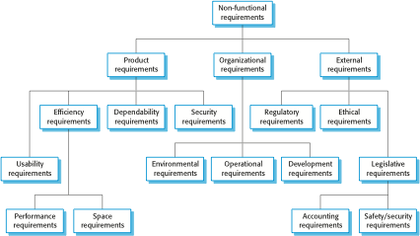
Types of Non Functional Requirement

Slide 9
NON-Functional Requirements Example:
Speed – how fast the system performs certain activities.
Availability – for how much of the time the system is available e.g. does it operate overnight, or every day of the year, or not.
Capacity – what the limits are of what the system is able to handle.
Reliability – how dependable the system is.
Usability – how easy the system is to use for the customer or end user.

Slide 10
NON-Functional Requirements Example:
Modified data in a database should be updated for all users accessing it within 2 seconds.
Emails should be sent with a latency of no greater than 12 hours.
Each request should be processed within 10 seconds.
The site should load in 3 seconds when the number of simultaneous users are > 10000
Users must change the initially assigned login password immediately after the first successful login. Moreover, the initial should never be reused.
Employees never allowed to update their salary information. Such attempt should be reported to the security administrator.
A website should be capable enough to handle 20 million users without affecting its performance
The software should be portable. So moving from one OS to other OS does not create any problem.
Privacy of information, the export of restricted technologies, intellectual property rights, etc. should be audited.

Slide 11
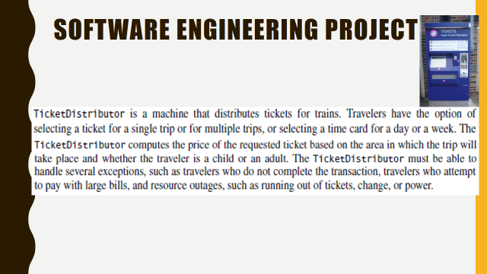
Example for functional & non-functional Requirements

Slide 12
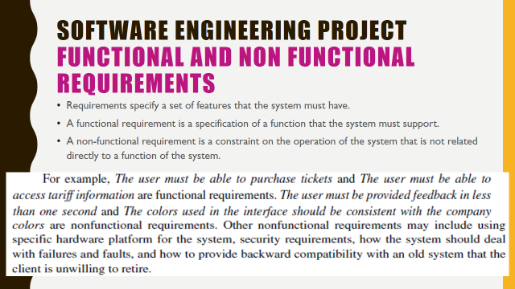
Example for functional & non-functional Requirements

Slide 13
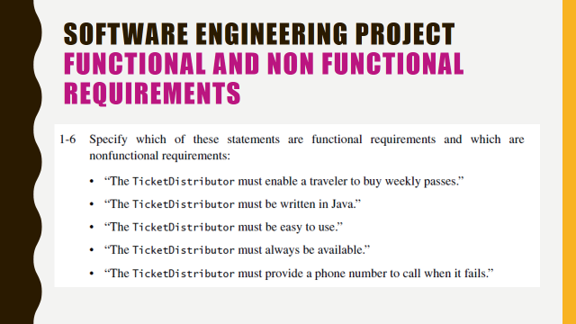
Example for functional & non-functional Requirements

Slide 14
ACTIVITY
Write 10 functional requirements of an Online Food Ordering Website.
Write 10 non-functional requirements of an Online Food Ordering Website.

